Slide 1

PrivacyLens: Sensitive Metadata Protection and Temporary Access Control for Digital Media
CSA5103 - Cryptography and Network Security
Presented by:
Rakshith R.R(192324156)
Harishvasan M(192521281)
Nagamokshith Koduru(192424083)
Surya R(1913260118)
Shivasachin S(192324276)
Guided by:
Dr. R. Dharani

Slide 2


Agenda
Introduction
Literature Survey
Problem Statement
Objectives
Proposed Architecture Diagram
Modules Introduction

Slide 3
Introduction
Digital media such as images, videos, and PDFs are widely shared through online platforms.
Media files may contain hidden metadata that reveals a user's location, device details, and activity timestamps.
Sharing files without removing sensitive metadata can expose personal information to unauthorized users.
Permanent file-sharing links may allow access even after the file is no longer needed.
PrivacyLens protects digital media through selective metadata removal, encryption, and time-limited access.

Slide 4
Literature Survey
Year | Author Name | Project Title / Research Paper | DOI Number | Advantages | Disadvantages
2024 | Abdullah Golam, Umar Albalawi | Invisible Boundaries: Balancing Image Metadata Privacy with Forensic Imperatives IJITS journal | 10.59035/JUXW2913 | Examines EXIF metadata privacy risks on social media; explores encryption and decryption of metadata. | Focuses primarily on image metadata; does not provide a complete temporary-link sharing and revocation workflow.
2025 | Roland Helmich, Lars Braubach | Securing End-to-End Encrypted File Sharing Services With the Messaging Layer Security Protocol Wiley Online Library | 10.1002/cpe.70414 | Combines end-to-end encryption, access control, and protected metadata storage; evaluates security and key-distribution scalability. | Group key management and implementation can be complex; does not specifically focus on EXIF sanitization.
2025 | Yun He, Xiaoqi Jia, Shengzhi Zhang, Lou Chitkushev | SeFS: A Secure and Efficient File Sharing Framework Based on the Trusted Execution Environment EUDL | 10.4108/eetss.v9i1.2854 | Uses a trusted execution environment to strengthen file-sharing security; addresses access control and secure cloud storage. | Relies on trusted hardware support; does not specifically address metadata removal or automatic expiry of sharing links.
2026 | Tran Thanh Lam Nguyen, Barbara Carminati, Elena Ferrari | ALIBIS: Assessing and Mitigating the Risk of Sensitive Metadata Leakage in Mobile Image Sharing ScienceDirect | 10.1016/j.pmcj.2026.102171 | Detects risks from sensitive EXIF metadata; combines static analysis and large language models; proposes a lightweight mitigation library. | Focuses on metadata-leakage assessment and mitigation; does not cover the full encrypted file-sharing and access-revocation lifecycle.
2026 | Namrata Naikwade, Shafi Pathan, Prashant Dhotre | Cost Efficient Storage and Swift Time-Bound Access Revocation Using Attribute-Based Encryption in Untrusted Cloud Environments Springer Nature Link | 10.1186/s13677-026-00861-1 | Supports time-bound access revocation and attribute-based access control; combines encryption with image compression to reduce storage costs. | Uses more complex cryptographic mechanisms; compression and attribute-based encryption may be unnecessary for a lightweight student application.
2026 | Shitong Bai, Jiawei Zhang, Jun Wu | Revocable and Time-Based Secure File Hierarchy Sharing in Cloud-Assisted Internet of Things Springer Nature Link | 10.1186/s42400-026-00660-w | Provides time-based access control, user revocation, data auditing, and efficient encrypted file sharing. | Targets hierarchical cloud and IoT data; implementation is more complex than a simple media-sharing application.

Slide 5
Problem Statement
Digital media files may contain hidden metadata that exposes users’ personal information, location, and device details.
Existing metadata removal methods may delete useful information along with sensitive data.
Conventional file-sharing links may remain accessible beyond the intended sharing period.
Lack of integrated access monitoring makes it difficult to identify unauthorized access attempts.
A unified framework is needed to combine selective metadata sanitization, secure encryption, temporary access control, and audit monitoring.

Slide 6
Objectives
To identify sensitive metadata in digital media files.
To remove sensitive metadata while preserving useful information.
To encrypt digital media to prevent unauthorized access.
To provide temporary access to shared files through expiring links.
To monitor file access and display security activities through a dashboard.

Slide 7
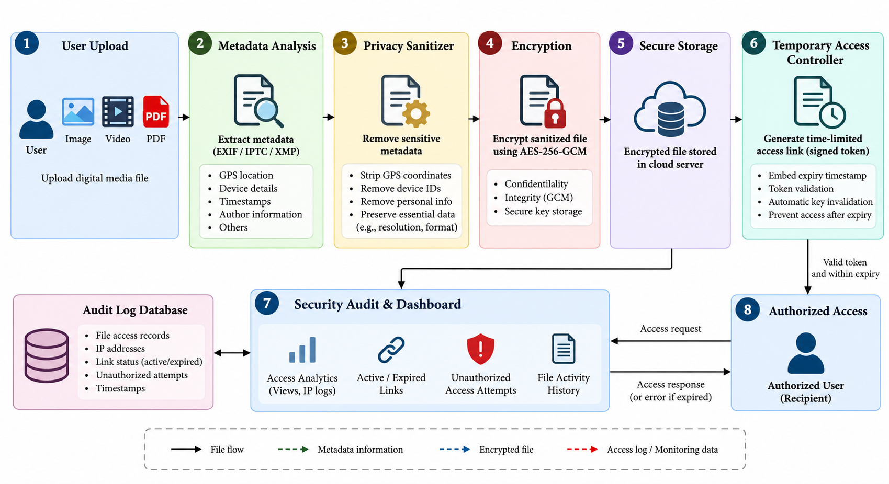
Proposed Architecture

Slide 8
Project Overview
Module 1: Digital Media Upload and Metadata Analysis
Upload media files and identify their hidden metadata.
Module 2: Sensitive Metadata Removal
Remove sensitive information while preserving essential file properties.
Module 3: Media Encryption and Decryption
Encrypt media files using AES-256-GCM to protect their contents.
Module 4: Temporary Access and Expiry Management
Generate time-limited sharing links and restrict access after expiry.
Module 5: Security Audit and Privacy Dashboard
Monitor file access, link status, and unauthorized access attempts.

Slide 9
THANK
YOU!

